Slide 1
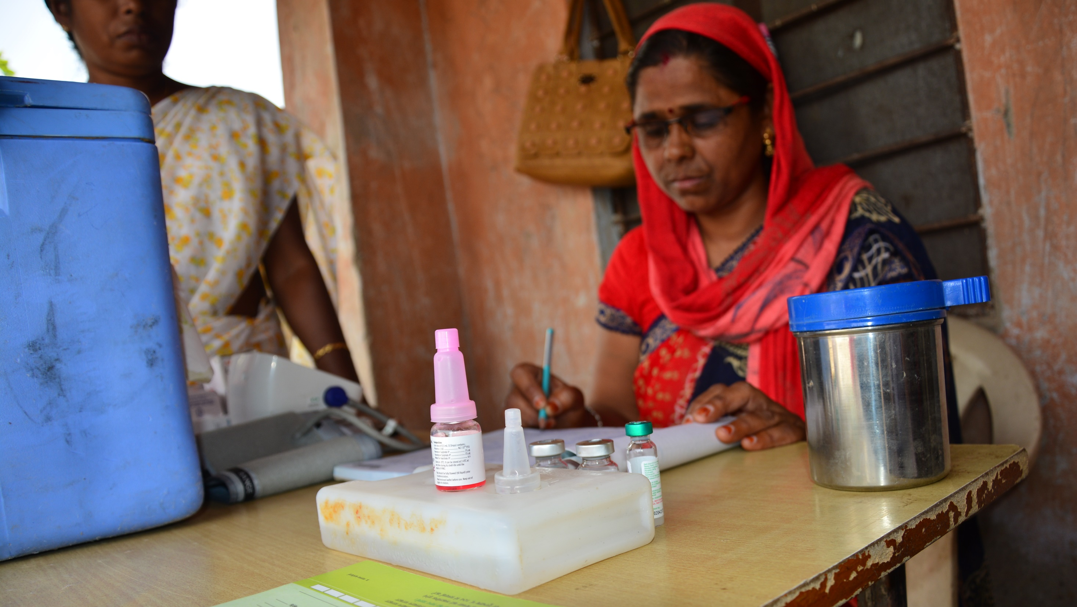

Recognizing and managing Anaphylaxis

Slide 2

Risk of anaphylaxis following vaccination is very rare (1-2 cases per million doses)
The onset of anaphylaxis occurs usually between few minutes to up to few hours following vaccination.
A case of anaphylaxis is suspected if the following criteria are met:
Sudden onset and rapid progression
At least one sign/symptom related to at least two of the following three systems - respiratory, cardiovascular and dermatological/mucosal
Recognising Anaphylaxis

Slide 3
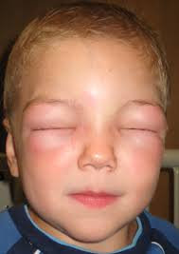
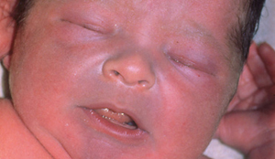
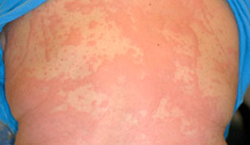
Signs and symptoms of Anaphylaxis
Dermatological or mucosal:
Raised red skin lesion, rash with itching over body – generalized urticaria
Redness of skin - generalized erythema
Itchy/ painful swelling of subcutaneous tissues such as upper eyelids, lips, tongue, face etc.
Itching of skin - generalized pruritis
Picture 1: Angioedema
Picture2 : Cyanosis
Picture 3: Urticaria

Slide 4
Signs and symptoms of Anaphylaxis
Respiratory:
Swelling of tongue, lip, throat
Difficulty in breathing
Harsh vibrating sounds during breathing from chest - stridor
Breathing with whistling or rattling sound in chest - wheezing
Bluish discoloration of arms and legs, tongue, ears, lips, etc.)- cyanosis
Noisy breathing - grunting
Cardiovascular:
Fainting, dizziness - Decreased level /loss of consciousness
Low blood pressure (measured hypotension)
Increased heart rate, palpitation- tachycardia

Slide 5
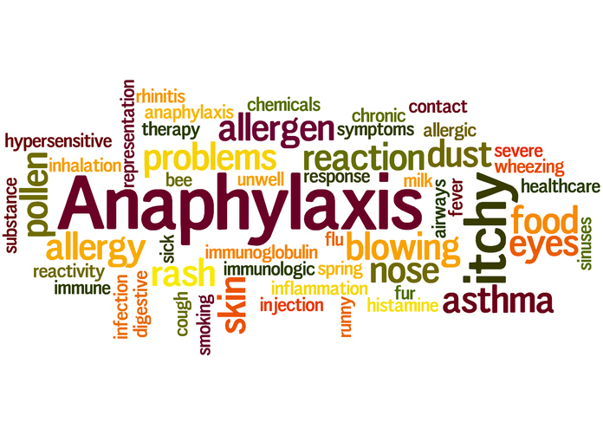
Recognising Anaphylaxis
Occasionally Symptoms
Anxiety; Diarrhoea; Abdominal cramps; Nausea- Vomiting; Sneezing or Rhinorrhoea

Slide 6
Differentiating anaphylaxis from fainting/syncope
 | Fainting/syncope | Anaphylaxis
Onset | Immediate - At the time or soon after injection | Usually some delay between 5–30 minutes after injection
Skin | Pale, sweaty, cold and clammy | Urticaria, swollen eyes, face; generalized rash.
Respiratory | Normal to deep breaths | Noisy breathing from airways obstruction
Cardiovascular | Bradycardia Strong carotid pulse | Tachycardia Weak carotids
 | Transient hypotension | Hypotension
Gastrointestinal | Nausea/Vomiting | Abdominal cramps
Neurological | Transient loss of consciousness, good response once prone | Loss of consciousness, little response once prone

Slide 7
Differences between Anaphylaxis, Breath holding spell, Convulsion
 | Breath holding spell (pallid type) | Generalised tonic clonic seizures | Anaphylaxis
Triggering factor | Triggered by sudden fright, pain or injury to head; Occurs in young children | Illness, fever, medication, or injury | Any drug including vaccine
Clinical features | Pale, loss of consciousness Facial flushing & cyanosis Sweating May become stiff, or have body jerks or loose bladder control | Tonic phase: loud crying/groaning, rigidity, clenching of teeth, blue lips Clonic phase: Resumes shallow breathing, quick & rhythmic jerking of limbs, contraction & dilation of pupils | Urticaria, swollen eyes, face; generalized rash. Noisy breathing from airways obstruction Tachycardia; Weak carotids Loss of consciousness, little response once prone
Duration | Brief episodes (lasting less than minute) | Generally lasts 1 to 3 minutes. Seizure lasting more than 5 minutes requires emergency medical help | With early and appropriate intervention, anaphylaxis can be managed in a few hours. Recovery of serious cases will take a few days. Death can occur within minutes or hours after onset.
Recovery | Child regain consciousness and will recognise people but can seem sleepy. | Child relaxes and may lose control of her bowel or bladder. child regains consciousness slowly and may appear drowsy, confused, anxious, or depressed

Slide 8
Initial management of suspected anaphylaxis case
Following vaccination, a case of anaphylaxis should be suspected if there is early onset of symptoms (within minutes to 6 hours) with rapid progression. In such a case,
Conscious child
Keep in a supine position with lower limbs raised higher than head level.
Unconscious child
Keep in left lateral position.
Immediate
As per the age of patient, administer one dose of injection adrenaline by deep intramuscular route.
Don’t be panicky & reassure the patient, parents and relatives
Suspected case should never be left alone
Prepare for transport to health facility

Slide 9
Initial management of suspected anaphylaxis case
Immediately arrange for an ambulance/vehicle to transport the patient to the nearest health facility (PHC/CHC/District Hospital, etc.).
Inform medical officer (telephonically) about the case with necessary details (name, age, date, time, site, route and dose of adrenaline administered) for further management at the health facility well equipped to manage anaphylaxis and for follow up.
Record the anaphylaxis reaction (suspected/confirmed) in the immunization card in block letters.
Future vaccinations should be given in hospital settings with adrenaline and other resuscitation equipment available at hand
Case details should also be recorded in AEFI register and reported in CRF as a serious/severe AEFI case by MO to the DIO.

Slide 10
Treatment at the health facility
Health facility must prepare to receive and manage the patient with anaphylaxis before the ambulance arrives – emergency tray/ AEFI management kit, resuscitation equipment, oxygen, etc.
Assess airway, breathing and circulation of the patient and manage as an emergency. If required administer subsequent doses of Adrenaline.
Patient should be kept hospitalized under observation for at least 12-24 hours
If needed, the case may be referred to higher facility for further management

Slide 11
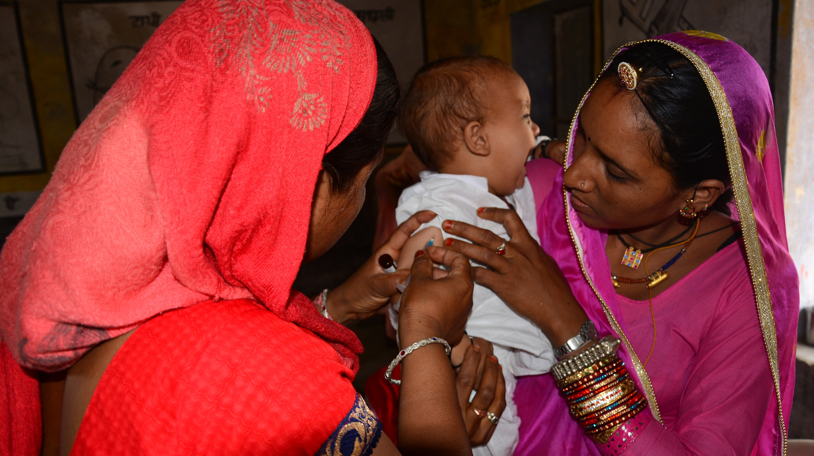
Use of Adrenaline by health workers/ ANMs

Slide 12
Suspecting Anaphylaxis
A case of anaphylaxis is suspected if the following criteria are met:
Sudden onset (few minutes to up to few hours following vaccination) and rapid progression
At least one sign/symptom related to at least two of the following three systems - respiratory, cardiovascular and dermatological/mucosal

Slide 13
Estimated burden of Anaphylaxis cases in India
Immediate management of Anaphylaxis
Reassure patient, parents/ relatives
Immediately administer single and age-appropriate dose of injection Adrenaline by deep IM route on anterolateral aspect of thigh
Seek help to immediately arrange for ambulance/vehicle to transport the patient to the nearest referral centre - PHC/CHC/District Hospital, etc.
Do not leave patient alone
If patient is conscious, keep in supine position with lower limbs raised higher than head
If patient is unconscious, keep in left lateral position

Slide 14
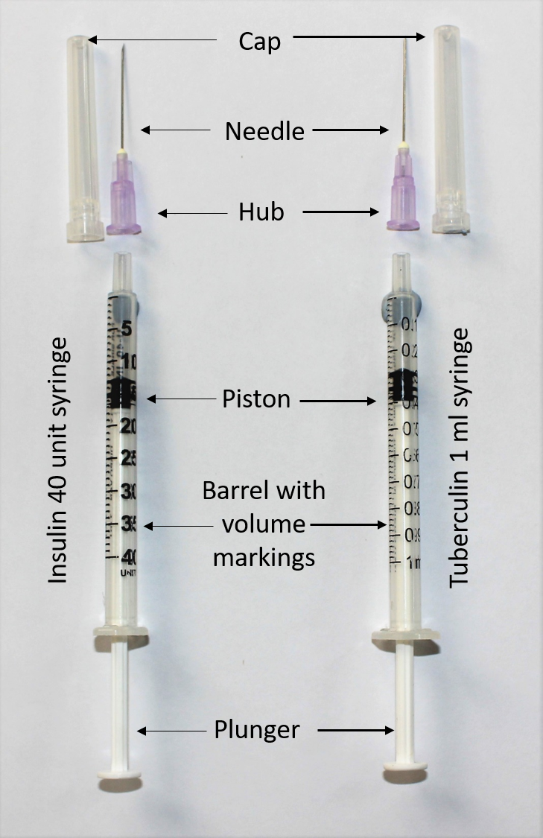
Intramuscular administration of adrenaline
ANMs already give most vaccinations intramuscularly (IM)
Adrenaline is also to be given IM
Use tuberculin or insulin syringe (without fixed needle)
Recommended needle size for intramuscular administration of adrenaline is 24 or 25 G one inch long.
Give single age –appropriate dose using tuberculin / insulin syringe.

Slide 15
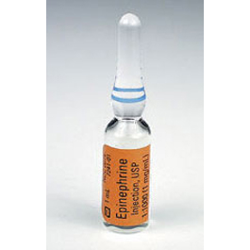
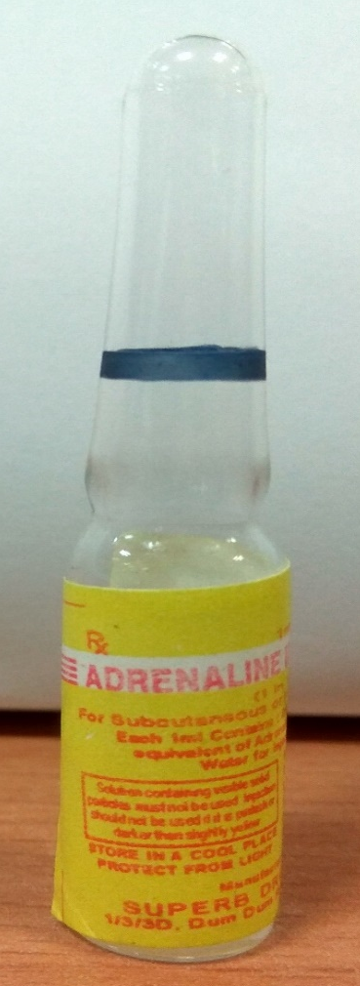
Steps for administration of injection Adrenaline
Take one ampoule of adrenaline (1:1000) solution from Anaphylaxis kit
Check name, dilution and expiry date on label of vial
Take a 1 ml tuberculin or a 40 units insulin syringe and 24/25 G one inch long needle
Adrenaline is also supplied in ampoules labelled as Epinephrine.

Slide 16
Steps for administration of injection Adrenaline
Use table for choosing adrenaline dose to be administered as per age of patient and available syringe
Load required dose of adrenaline in the syringe.
Age specific dosing chart of adrenaline (1:1000) dose for management of anaphylaxis
Age group (in years) | Needle | Dose for single administration in ml (tuberculin) or units (insulin)
0-1 | 1 inch long of 24G or 25G | 0.05 ml / 2 units
1-6 |  | 0.1 ml / 4 units
6-12 |  | 0.2 ml / 8 units
12-18 |  | 0.3 ml / 12 units
Adults |  | 0.5 ml / 20 units

Slide 17
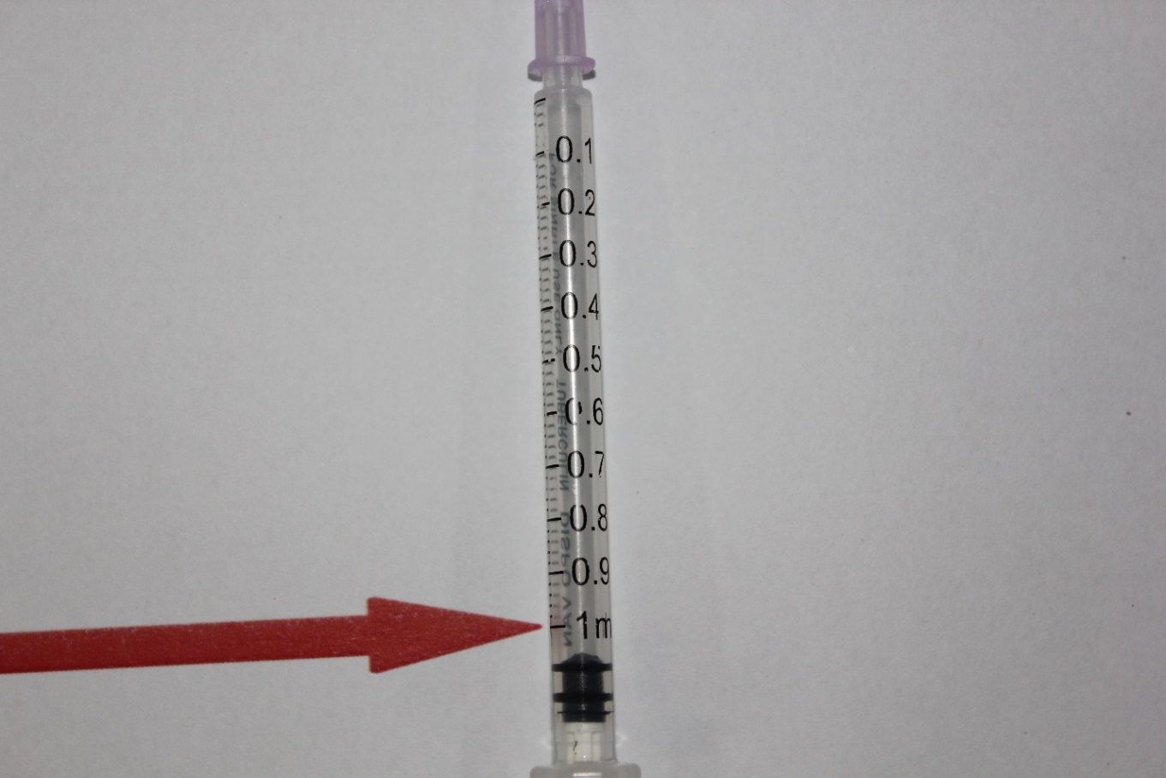
Gradations on 1 ml (tuberculin) syringe
Availability of appropriate syringes and needles
As part of Anaphylaxis kit, states/district will procure and supply
1 ml syringe (tuberculin) with 50 gradations (one gradation = 0.02 ml) without fixed needles – 3 nos./sub centre or ANM
OR
40 units syringe (insulin) with 40 gradations (one gradation – 1 unit) without fixed needles – 3 nos./sub centre or ANM
1 inch needle of 24/25 G – 3 nos./sub centre or ANM
0.05 ml
0.1 ml
0.2 ml
0.3 ml
0.5 ml
Notes:
Normally 1ml tuberculin syringe comes with 0.5 inch of detachable needle , hence it is advisable that separate 1 inch needle should be made available for their use in anaphylaxis kit.

Slide 18
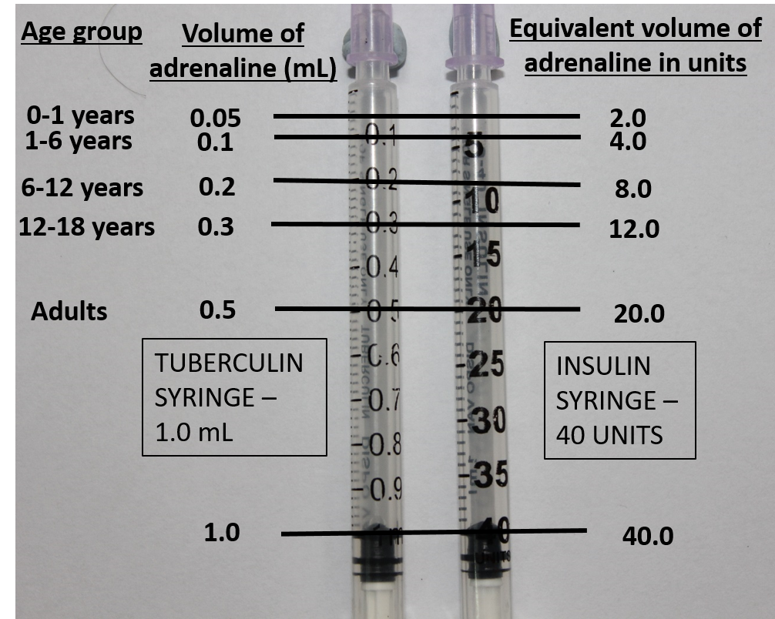
Markings of age appropriate dosage of adrenaline in mL (tuberculin syringes) and equivalent volume in units (insulin syringes)
Corresponding volume markings on Insulin & tuberculin syringes

Slide 19
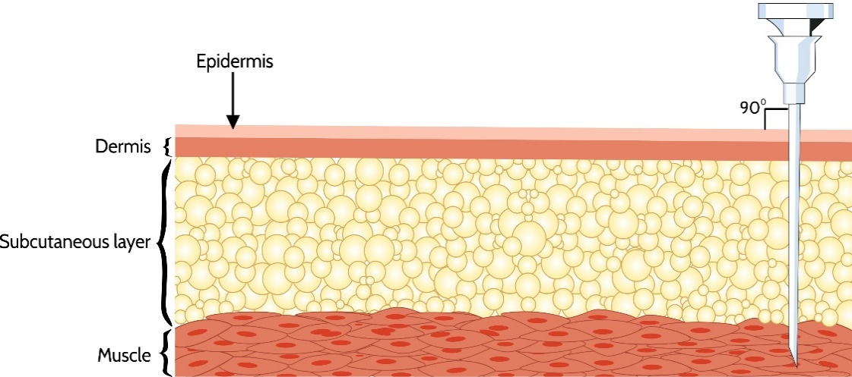
Steps for administration of injection Adrenaline
Use swab to clean skin on mid 1/3rd of anterolateral aspect of thigh of the opposite limb to that in which vaccine was given.
Hold the muscle mass on the anterolateral aspect of thigh with hands, stretch the skin (do not bunch) with fingers.
Give deep intramuscular injection at 90 degree angle to skin in middle 1/3rd of anterolateral aspect of thigh.

Slide 20
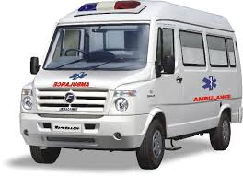
Immediate transportation to health facility
Call an ambulance or arrange a vehicle immediately for transportation to nearest referral centre/health facility
Note time, date and dose of adrenaline administered on the immunization card
Inform medical officer about the case for timely management.
If Anaphylaxis is confirmed following vaccination, it should be written on the immunization card in block letters so that the same vaccine is not administered again.

Slide 21
Points to remember (1)
Ask all beneficiaries to wait for 30 minutes after vaccination at the session site.
Always keep an anaphylaxis kit ready at every immunization session.
Ensure that the Medical Officer certifies expiry dates of adrenaline and other contents of the anaphylaxis kit every three months.
Check the label of the adrenaline ampoule for expiry date before administration.
Use the dose chart to find the age appropriate dose of adrenaline

Slide 22
Points to remember (2)
Immediately administer a single age appropriate dose of inj. Adrenaline to a suspected case of Anaphylaxis by deep intramuscular route on the anterolateral aspect of the mid – thigh.
After administrating adrenaline, inform the medical officer of nearest health facility about the case for timely management.
Mention time, date and dose of adrenaline administered on the immunization card in BLOCK letters.
Arrange for an ambulance to transport the child to the health facility.
Ensure this case is recorded in the PHC AEFI register.

Slide 23
Summary
Anaphylaxis is characterized by early onset and rapid progression of symptoms
Suspect
At least one sign/symptom related to at least two of the following three systems - respiratory, cardiovascular and dermatological/mucosal
Adrenaline is the drug of choice for managing anaphylaxis
Immediately give the first dose on suspicion
Early administration of adrenaline is linked with rapid recovery and less severe sequelae
Refer and transport case immediately to health facility equipped with resuscitation equipment
Further vaccinations to be given under medical supervision in health facilities

Slide 24
THANK YOU

